Slide 1




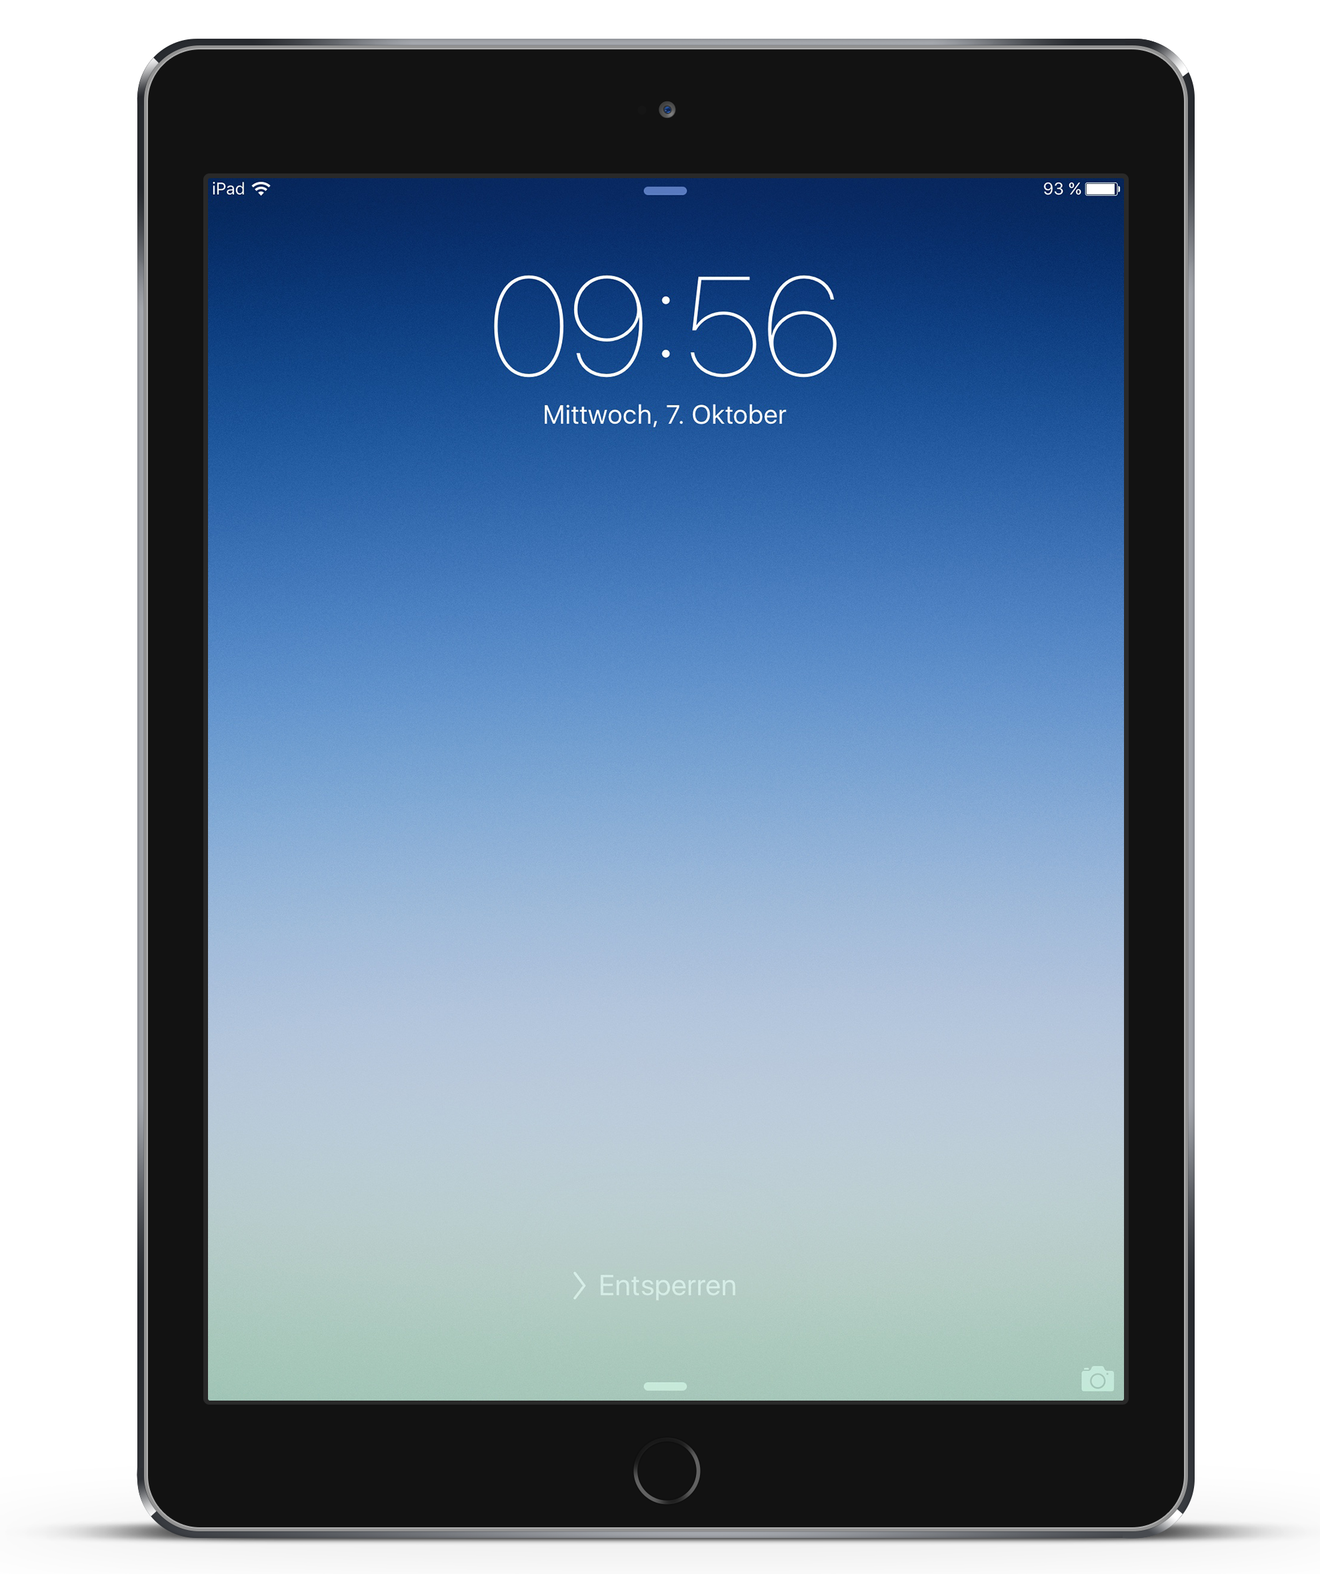
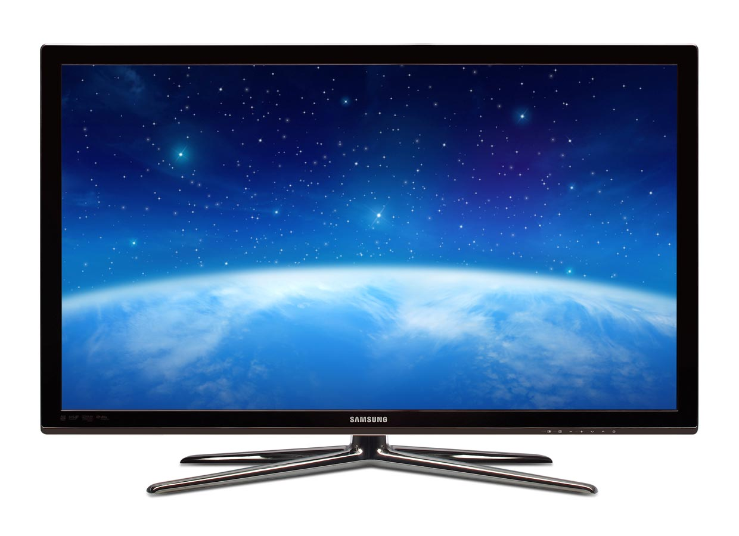
FIT A.I MVP – summer 2016
input
process
output
movement (x,y,z) acceleration
user
ID
exercise
Athlete: John Smith
Exer.: Shoulder press
Weight: 85lb
weight
meta, acceleration
exercise
up
down
Sensor:
Athlete taps his NFC bracelet (wakes up the sensor). Athlete verifies the three pieces of information displayed on the screen. Movements are recorded. Sensor calculates the overall acceleration and converts it into meters per second. Sensor sends the user’s metadata and the acceleration over to the Amazon Web Services.
AWS: Stores the data, does further analysis and display’s it on the screen
manual input: -tap ID (NFC) -weight (buttons) -exercise (buttons)
automatic input: -acceleration (x,y,z axis) -time
Data is available to be displayed on a TV, PC or iPad

